Slide 1
Chapter 19: thermodynamics
Dr. Aimée Tomlinson
Chem
1212

Slide 2
Review from Chapter 5
What you should know about thermochemistry

Slide 3
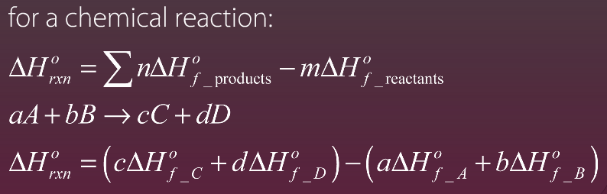
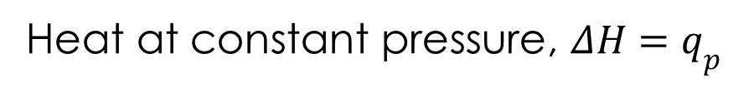
Enthalpy
Heat at constant pressure, $ΔH=q_{p}$

Slide 4

Hess’s Law

Slide 5
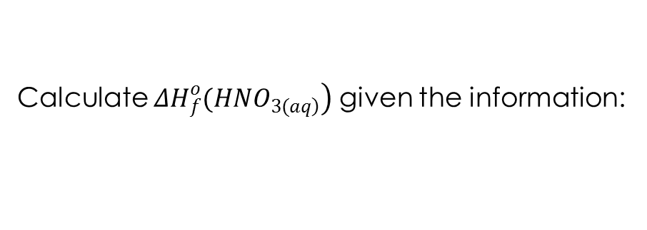
Hess’s Law Example
Calculate $\left.ΔH_{f}^{o}(HNO_{\left.3(aq\right)}\right)$ given the information:

Slide 6
Section 19.1
Spontaneous Processes

Slide 7



Oh to be spontaneous

Slide 8
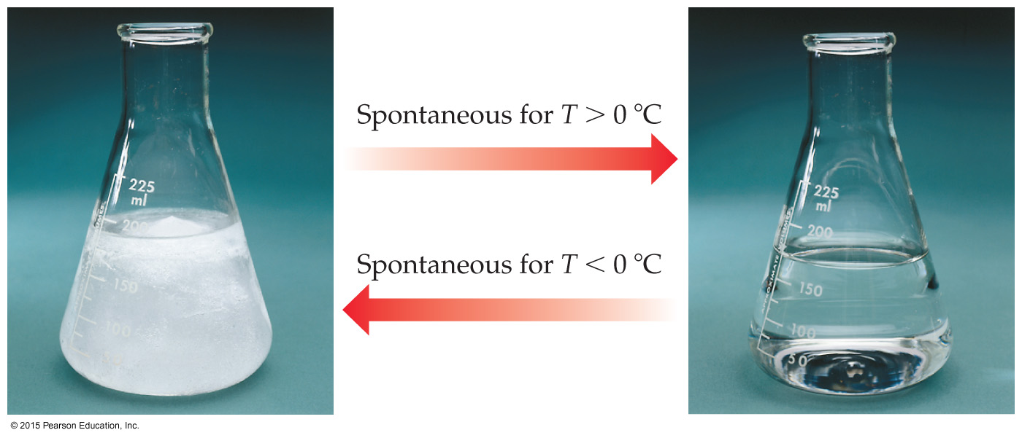

Experimental Conditions & Spontaneity
Temperature and pressure can affect spontaneity.
An example of how temperature affects spontaneity is ice melting or freezing.

Slide 9
Section 19.2
Entropy & the Second Law of Thermodynamics

Slide 10
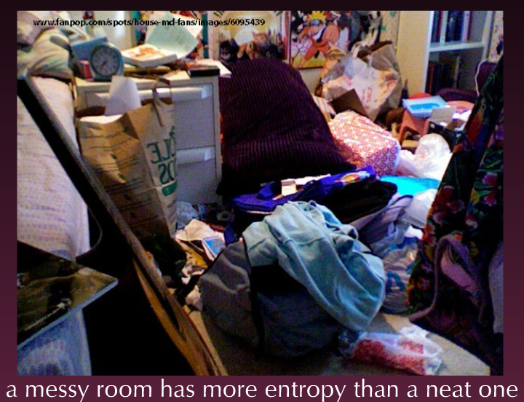

Entropy
Defn: system disorder, randomness, motion

Slide 11
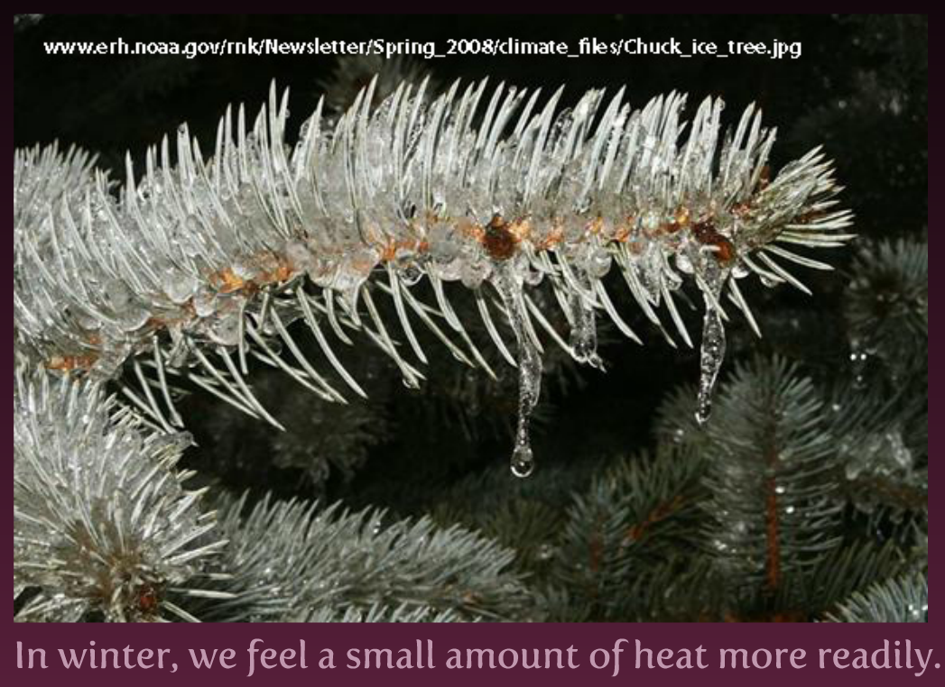
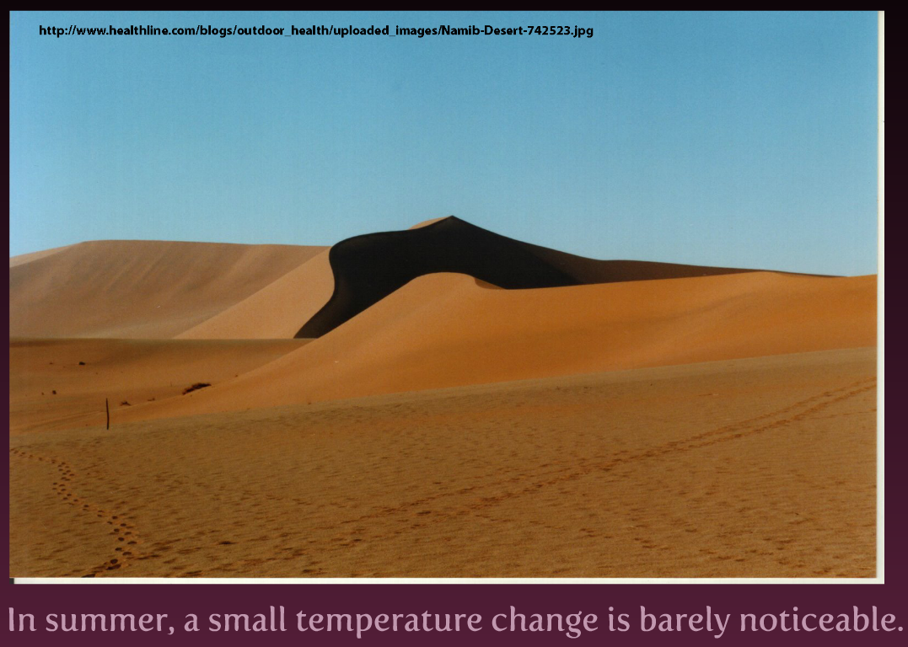
Effect of T on S
Entropy changes as a consequence of heat flow
Heat flow at lower T has a greater impact

Slide 12

System, Surroundings and heat
The sign is dependent on the direction of heat flow
The magnitude is dependent on T

Slide 13

Mathematically

Slide 14
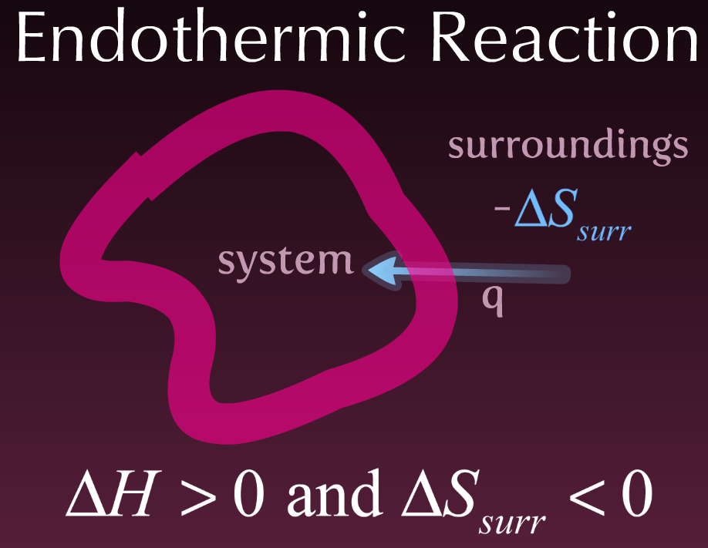
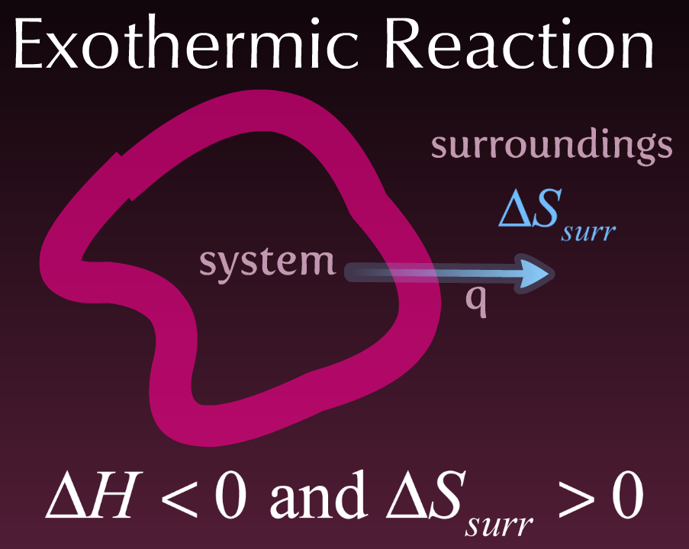
Two Directions of Heat Flow

Slide 15
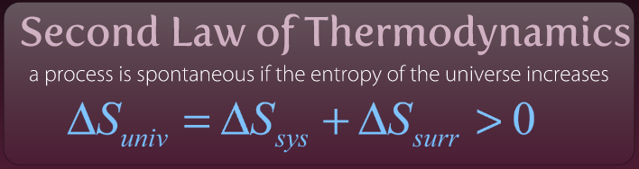
The Second Law of Thermo
If we increase the number of gas moles from reactants to products we increase ΔS_{univ}
C₃H_{8(g)} + 5O_{2(g)} → 3CO_{2(g)} + 4H₂O_{(g)} – we increase from 6 to 7 gas moles so as expected our ΔS_{univ} > 0
X 4

Slide 16
Sections 19.3
Molecular Interpretation of S & the 3rd Law of Thermodynamics

Slide 17
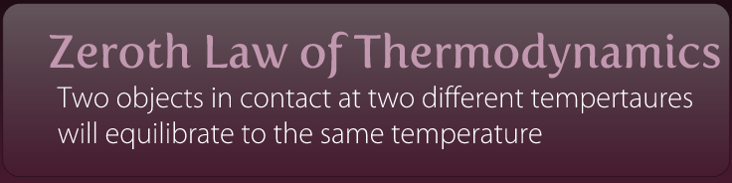
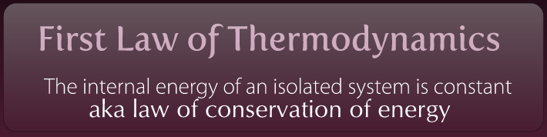
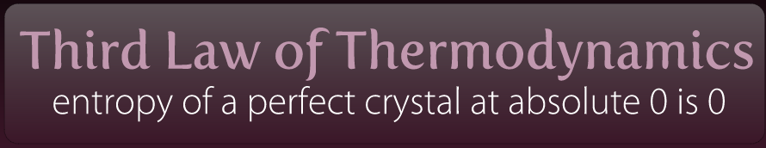
Laws of Thermodynamics

Slide 18
Section 19.4
Entropy Changes in Chemical Reactions

Slide 19
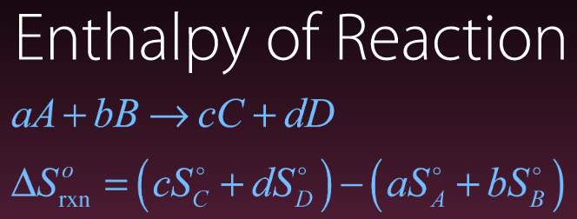
Standard Molar Entropy
Defn: Entropy of a substance at P = 1 bar & T = 298.15K
For homework you will be asked to look up values in the appendix

Slide 20
Example Entropy of Reaction
Compute $ΔS_{\text{rxn}}^{o}$ the for the following reaction and using the values given in the table below.
C₃H_{8(g)} + 5O_{2(g)} → 3CO_{2(g)} + 4H₂O_{(g)}
Compound | S⁰ (J/mol K)
C₃H_{8(g)} | 269.9
O_{2(g)} | 205.0
CO_{2(g)} | 213.6
H₂O_{(g)} | 188.7
X 3

Slide 21
Sections 19.5 &19.6
Gibbs Free Energy
&
Free Energy & Temperature

Slide 22
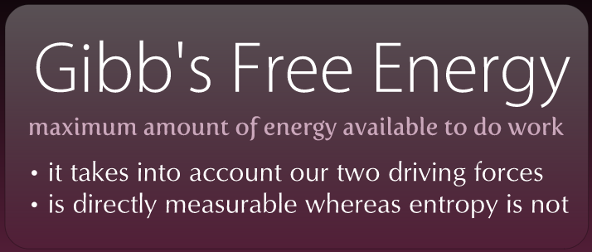
Gibb’s Free Energy – meet ΔG
There are two driving forces for any chemical reaction:
Formation of low energy products from high energy reactants, ΔH_{rxn}
Formation of high entropy products from low entropy reactants, ΔS_{rxn}

Slide 23
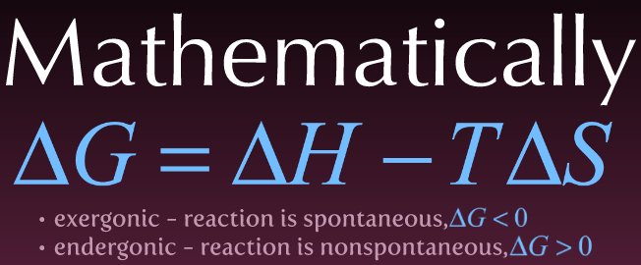
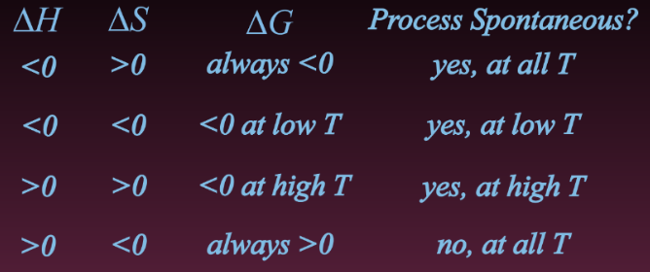
How Gibb’s Works

Slide 24
Gibb’s Example I
The standard enthalpy and entropy changes for the combustion of methane
are -801 kJ and -5 J/K, respectively Is the reaction spontaneous under
standard conditions?

Slide 25
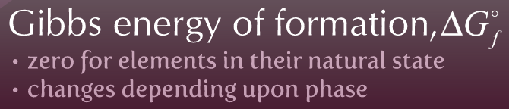
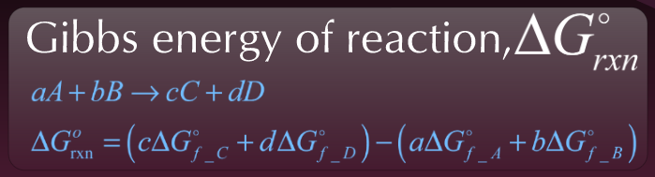

Slide 26
Gibb’s Example II
Is the reaction below exothermic or endothermic? Is the reaction spontaneous at all temperatures? Determine the Gibb’s free energy from the given data as well as using the mathematical equation
Compound | ΔH⁰f (kJ/mol) | Sº (J/mol*K) | ΔG⁰f(kJ/mol)
N_{2(g)} | 0.0 | 191.5 | 0.0
H_{2(g)} | 0.0 | 130.6 | 0.0
NH_{3(g)} | -46.1 | 192.3 | -16.5
X 3

Slide 27
Section 19.7
Free Energy & the Equilibrium Constant

Slide 28
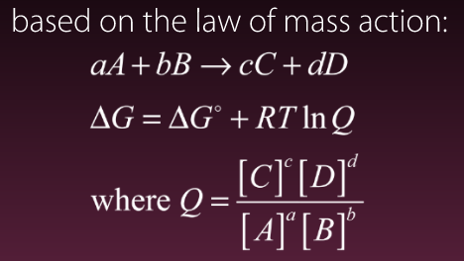
Relationship between Gibb’s & P

Slide 29
Gibb’s Example III
Determine the Gibb’s free energy for the reaction below.
 | NO_{(g)} | O_{3(g)} | NO_{2(g)} | O_{2(g)}
ΔG⁰ (kJ/mol) | 87 | 163 | 52 | 0
P (atm) | 1x10⁻⁶ | 2x10⁻⁶ | 1x10⁻⁷ | 1x10⁻³

Slide 30
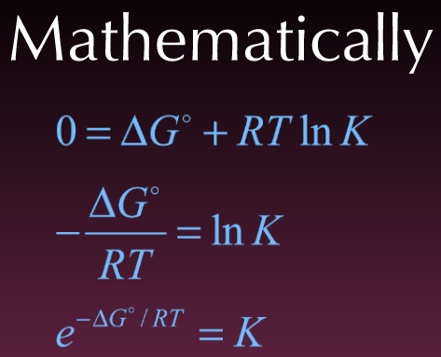
Relationship between Gibb’s & K
At equilibrium ΔG = 0

Slide 31
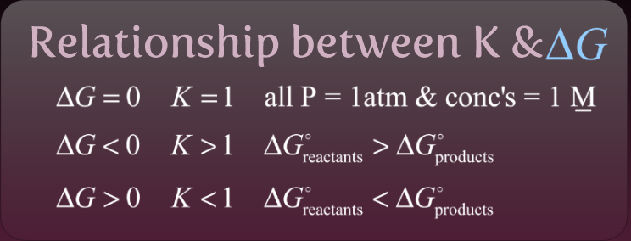
Relationship between Gibb’s & K

Slide 32
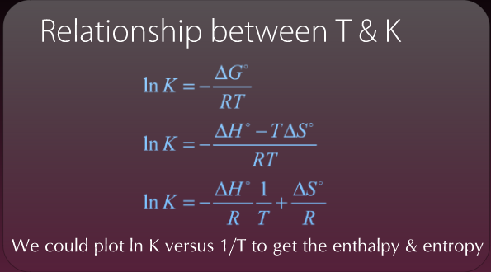
Plotting to get Enthalpy & Entropy

